Slide 1
IDENTIFICATION OF SPAM EMAILS
Using CART ANALYSIS

Slide 2
Contents
Why(the problem statement )
Problem survey
Objectives
Methodology (how do we implement that)
Time line

Slide 3
Why
Corona virus
Digitalized world
Email (the professional and traditional way to communicate )

Slide 4
Recent attacks
More than 168 phishing after the global pandemic (from December) on reputed companies like google, amazon etc
Spyware (data leaks),url spoofing's , ransomware etc
And each of cost almost 45m$ on average
Thousands of peoples are been effected due to these kind of attacks

Slide 5
Some of them
Coronavirus: Malwarebytes identifies new e-book phishing scam impersonating the WHO(https://portswigger.net/daily-swig/coronavirus-malwarebytes-identifies-new-e-book-phishing-scam-impersonating-the-who)
USB phishing attack baits victims with $50 gift card(https://portswigger.net/daily-swig/usb-phishing-attack-baits-victims-with-50-gift-card)
Indian blood donor charity leaks data of more than 12,000 citizens(https://portswigger.net/daily-swig/indian-blood-donor-charity-leaks-data-of-more-than-12-000-citizens)

Slide 6
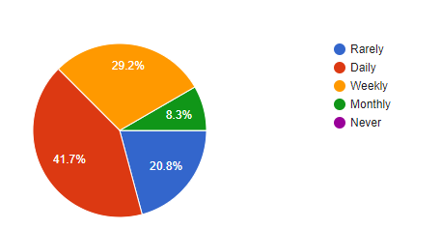
Problem survey
https://forms.gle/uy9ZvyLDXtUYezEq7

Slide 7
More results in survey
Out of 20.6 % how proceed to trust them
16.7 percent of people fall to victims of scams
And 8% of all lost there money

Slide 8
introduction
E-mail is daily used by millions of people to communicate around the globe and is a mission-critical application for many businesses. With the rapid adaption of Internet as an easy way to communicate, the amount of un-solicited e-mails, known as spam e-mails, is growing rapidly. E-mail users spend time in deleting the spam message which occupies large storage space in server side and utilizes more network bandwidth and also degrades the effective transmission speed in the network.

Slide 9
Objectives
To give knowledge to the user about the fake e-mails and relevant e-mails To classify that mail spam or not
to show that the spam filtering problem can be simplified into a two-dimensional classification problem, requiring only the spam and ham word frequencies for each message.
to prove that a neural network can perform the non-linear partitioning of this feature spam

Slide 10
CART analysis
CART analysis works by analyzing the data and creating a decision tree. The decision tree is then used to classify emails as either spam or non-spam. It uses a variety of features such as the sender's address, the content of the email, and the frequency of the email to make a decision. CART analysis is a powerful tool that can be used to detect spam emails and protect users from malicious emails.

Slide 11
DATASET
Email data from Enron
All types of mails
Classified into spam and non spam
Subject: security alert - confirm your national credit union information - - > 1
Subject: re : rabi de ' s sign on bonus sorry vince i have been out of town . please give me a call tomorrow . 0

Slide 12
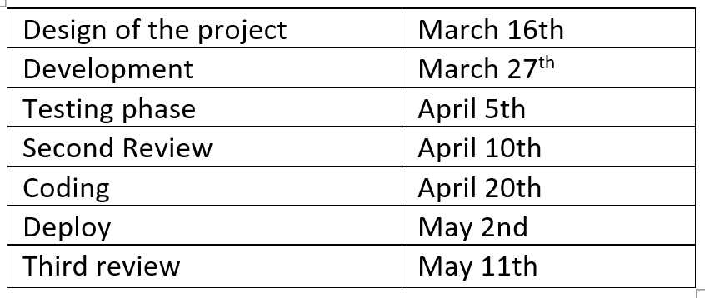
Time line

Slide 13
Thank you

